Slide 1
Morphological Image Processing to reduce Bad Textures
by Raghav Hari Krishna V S

Slide 2
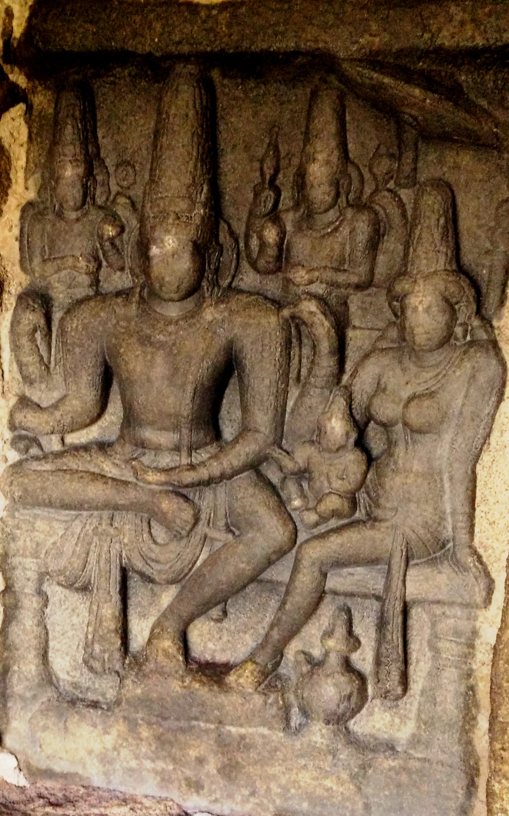
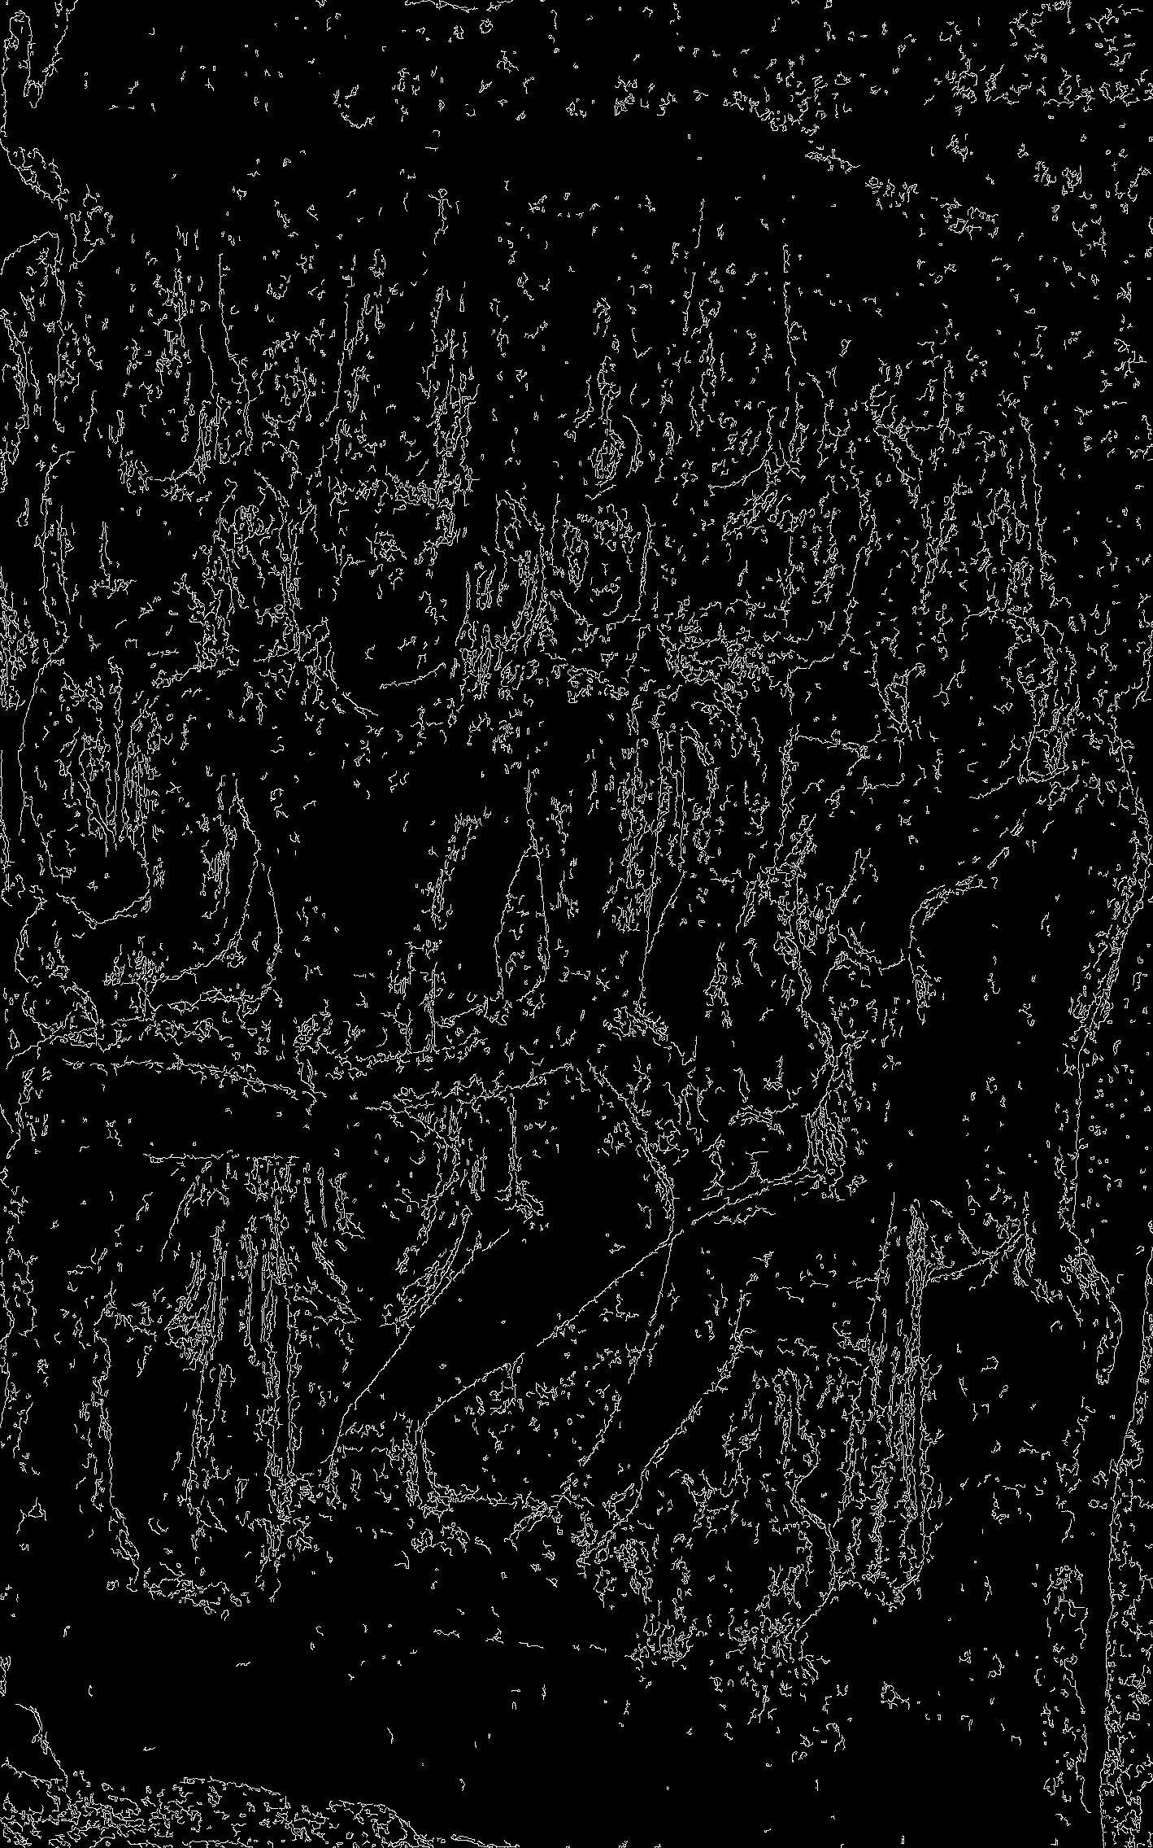
Problem Statement
To reduce “bad textures” in images to increase the value of features needed for training neural networks.
What are bad textures?
Textures which do not contribute/negatively contributes to training. E.g. Stone Noise

Slide 3
Methods
Morphology – used to remove noise
Opening – Erosion followed by dilation
Closing – Dilation followed by Erosion
Extraction – Obtaining the outline of the image
Boundary extraction
Subtract image from eroded image
Morphological Extraction
Difference between eroded and dilated image

Slide 4
Attempts
Masking
Mask the entire image and then perform morphology.
Results were mediocre at best.
Custom erosion and dilation function took too long (5s vs 0.2s / image)
Hacky solutions → loss in features and pixel data. (especially when working with color)
Precise outline masks could work – But would require mask for each image

Slide 5
Simple Morphology
Combinations tested
C
CO
COO
O
OC
OCC
OCO
OCOC
OOC
OOCC
Closing→Opening works best. (very, very subtle differences b/w most.)
Kernel Size 7.
Boundary extraction (image ~ eroded image)
Pros:
Gave stark outlines.
Better internal features
Thinner and fainter images than Morphex
Morphology extraction (eroded ~ dilated)
Pros:
Much thicker outlines
Brighter features (depth!?)
Noise became artifacts
11 images * 3 outputs each *10 combinations = 330 images to compare!

Slide 6
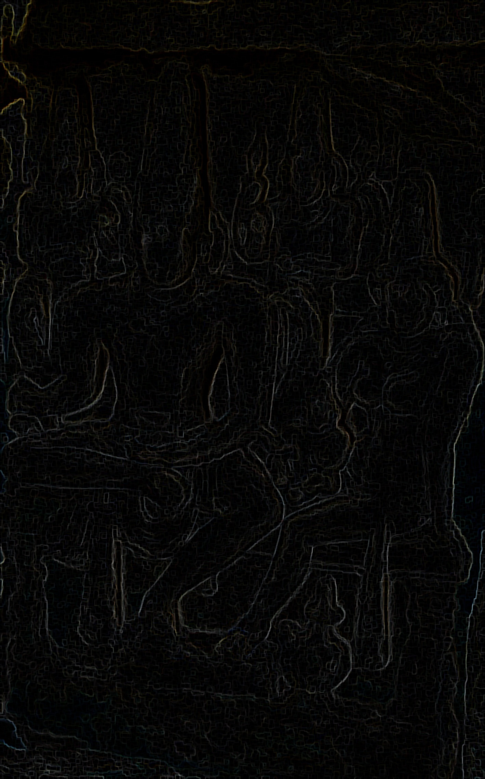
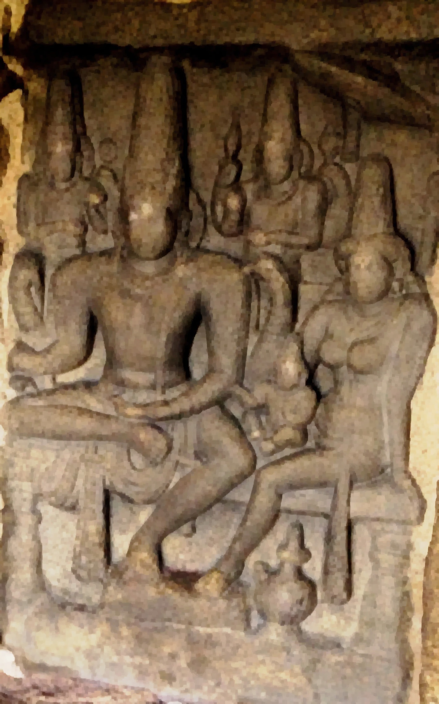
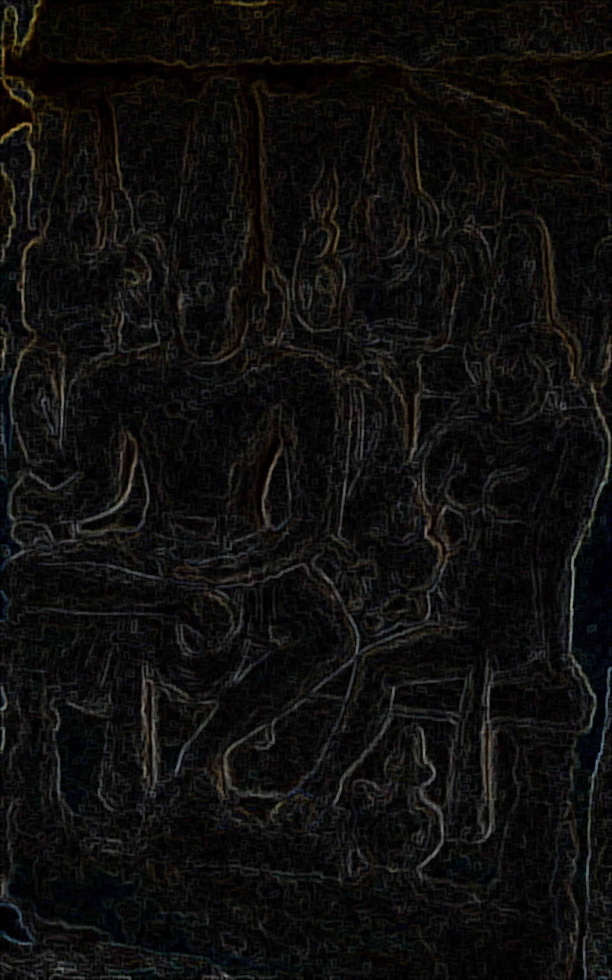
Boundary ← CO{7} → MorphEx

Slide 7
Results
Stone Noise reduced significantly when closed before opening.
Remove noise → amplify noise → remove noise
Stacking opening and closing does not help beyond 3 operations. Features lost.
Color image better than binary image for processing (!)

Slide 8
Goals vs Achievements
Study and analyse morphology.
Fast for batch processing.
Maintain features for training.
CO + Morphex works best.
9 sec to write 330 images.
Morphex images amplify outlines while significantly reducing bad textures.

Slide 9
Thank you
Any questions?

